Slide 1
Literacy lives here.
Resources made by Otherwise Education for On the Record.
Portait photographs by Fatimah Zahmoul. Film by Patrice Etienne.

Slide 2
What have we been learning about?
Newham Bookshop is at the heart of a rich culture of reading, writing and books, in our area.
Newham is a brilliant place to be a reader, and there is a community out there ready to welcome us.
Newham is home to a diverse and creative group of writers who live lives just like our own.
We can all be a part of this if we would like.

Slide 3
Share:
Did any of you develop your pieces of writing that we started
in the last lesson?

Slide 4
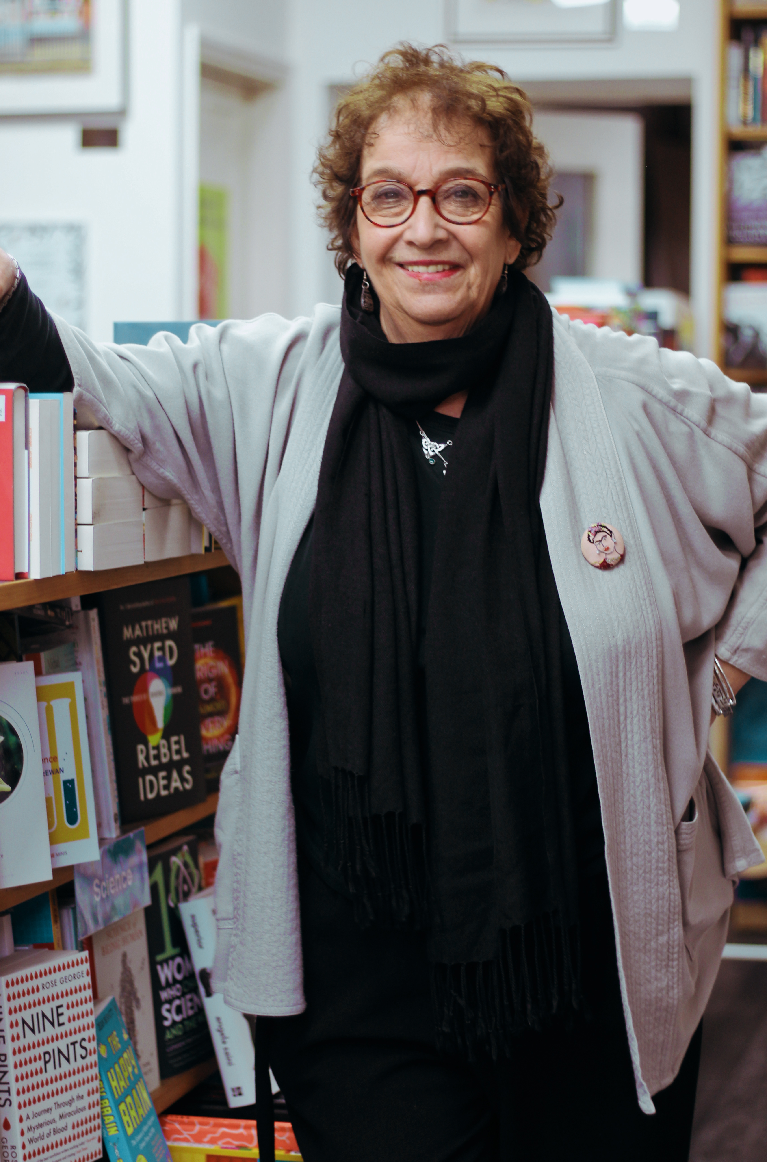
Vivian Archer
‘We’ve had people who buy their first Ladybirds here, and then come back and they’re professors and they’ve never forgotten the shop. We have an author, a local author, who is totally amazing, called Vaseem Khan, who writes crime fiction, and he always talks about what a difference it made to him to have this bookshop here when he was a young boy.’
Notes:
Your literacy

Slide 5
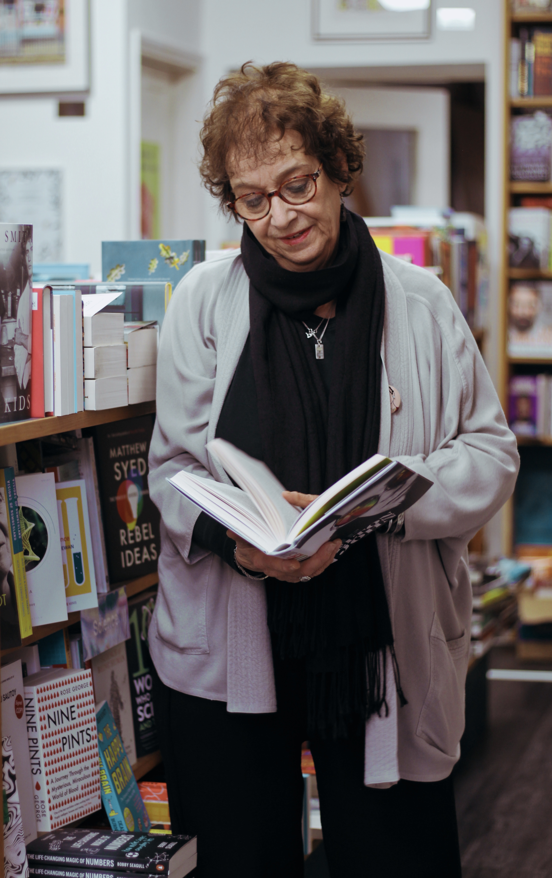
Vivian Archer
‘We’ve had some massive signings in here. We did Imran Khan. We had Benazir Bhutto in here. Just shortly before she was assassinated… She got out of the taxi and my daughter was the main security [laughs].
I mean, it was amazing. And she sat here. And everybody brought their babies. She was here for absolutely ages.’
PICTURE OF VIVIAN
Notes:
The world comes to Newham.

Slide 6
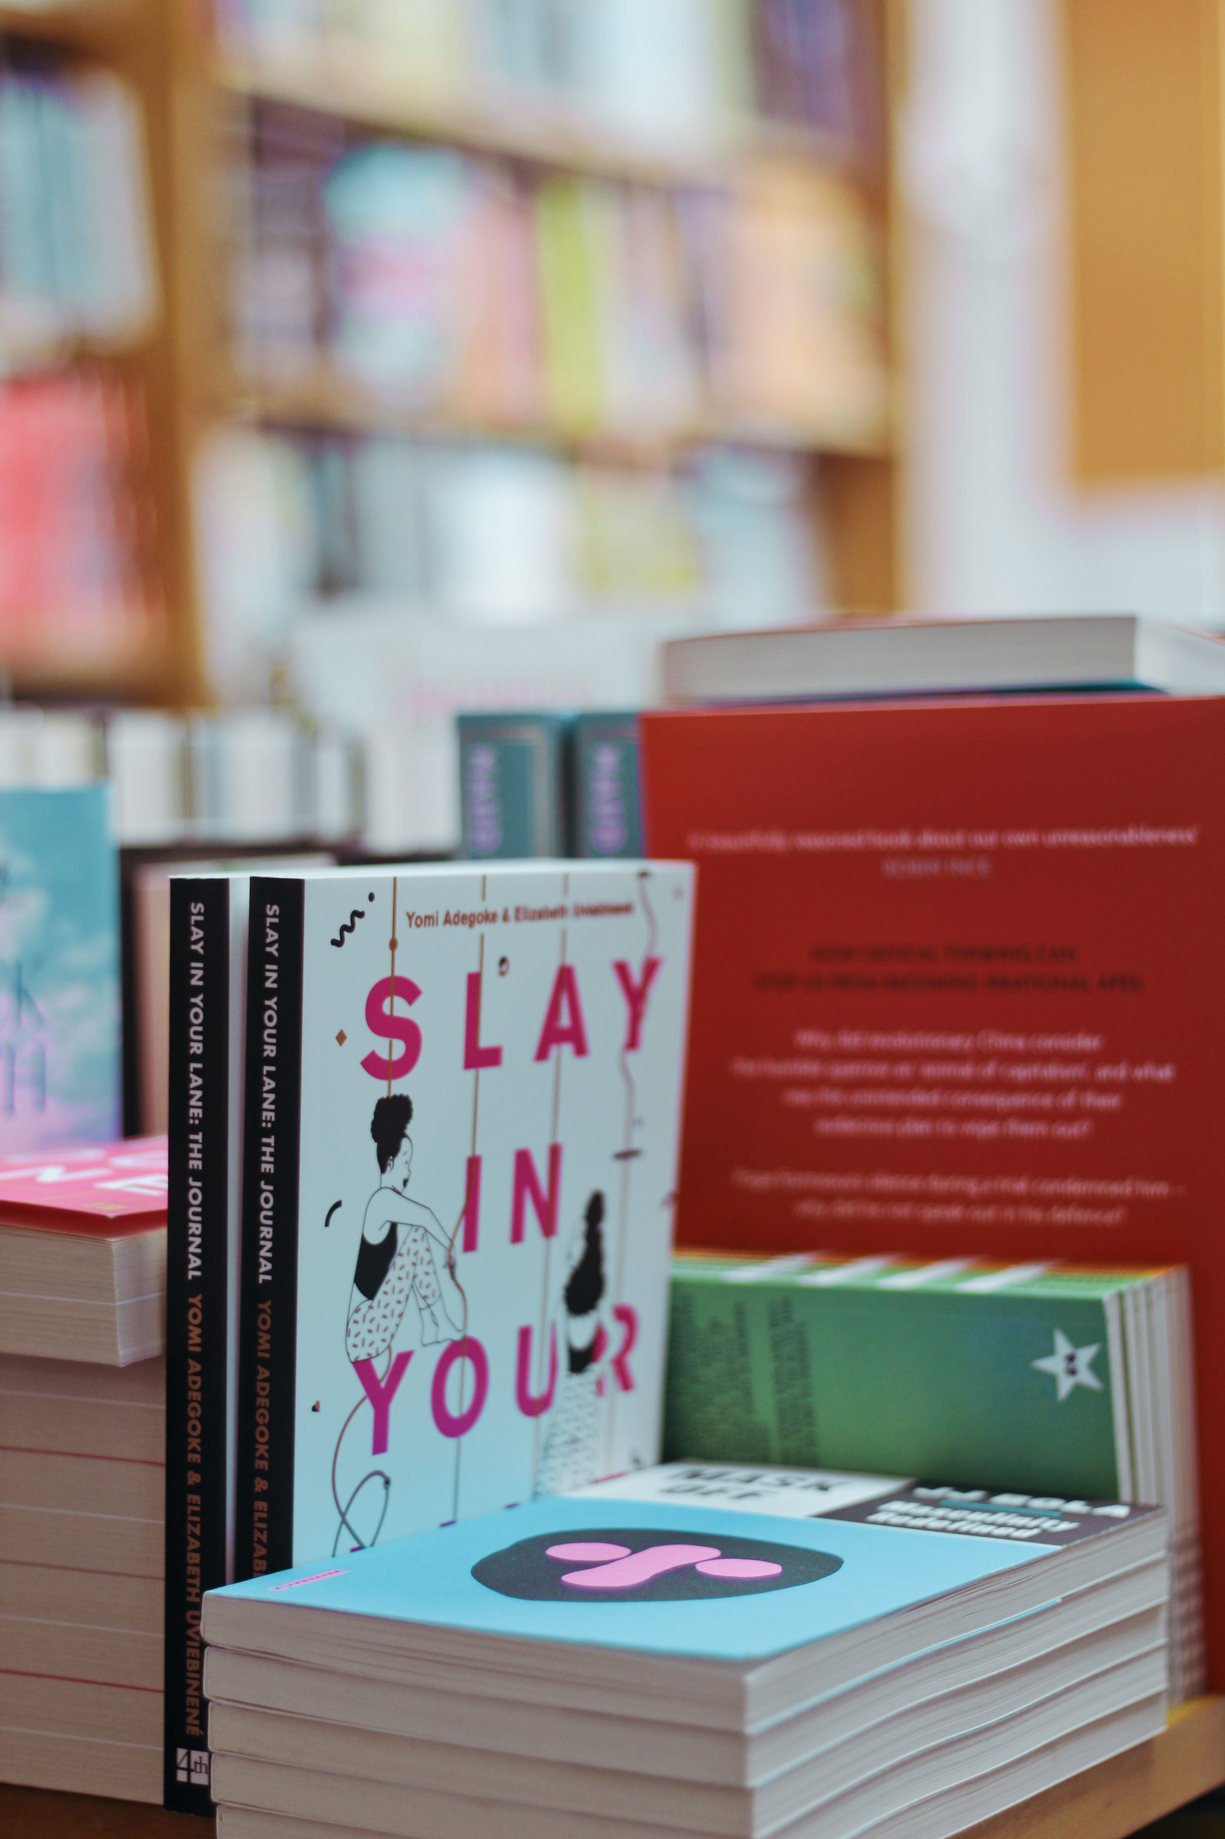
Dan Clapton
‘People have this culture on their doorstep, and it’s here for them. People will say, ‘How does the bookshop survive where it is?’
Because people know about it, and they make the effort to go there. And also, the whole community goes to that shop. It’s not just your typical white middle - class bookshop.
It appeals to absolutely everyone.’
Notes:
Your literacy

Slide 7
Next Deborah Peck
tells us about all the fun things we can do in Newham’s Libraries.
Watch the video...

Slide 8
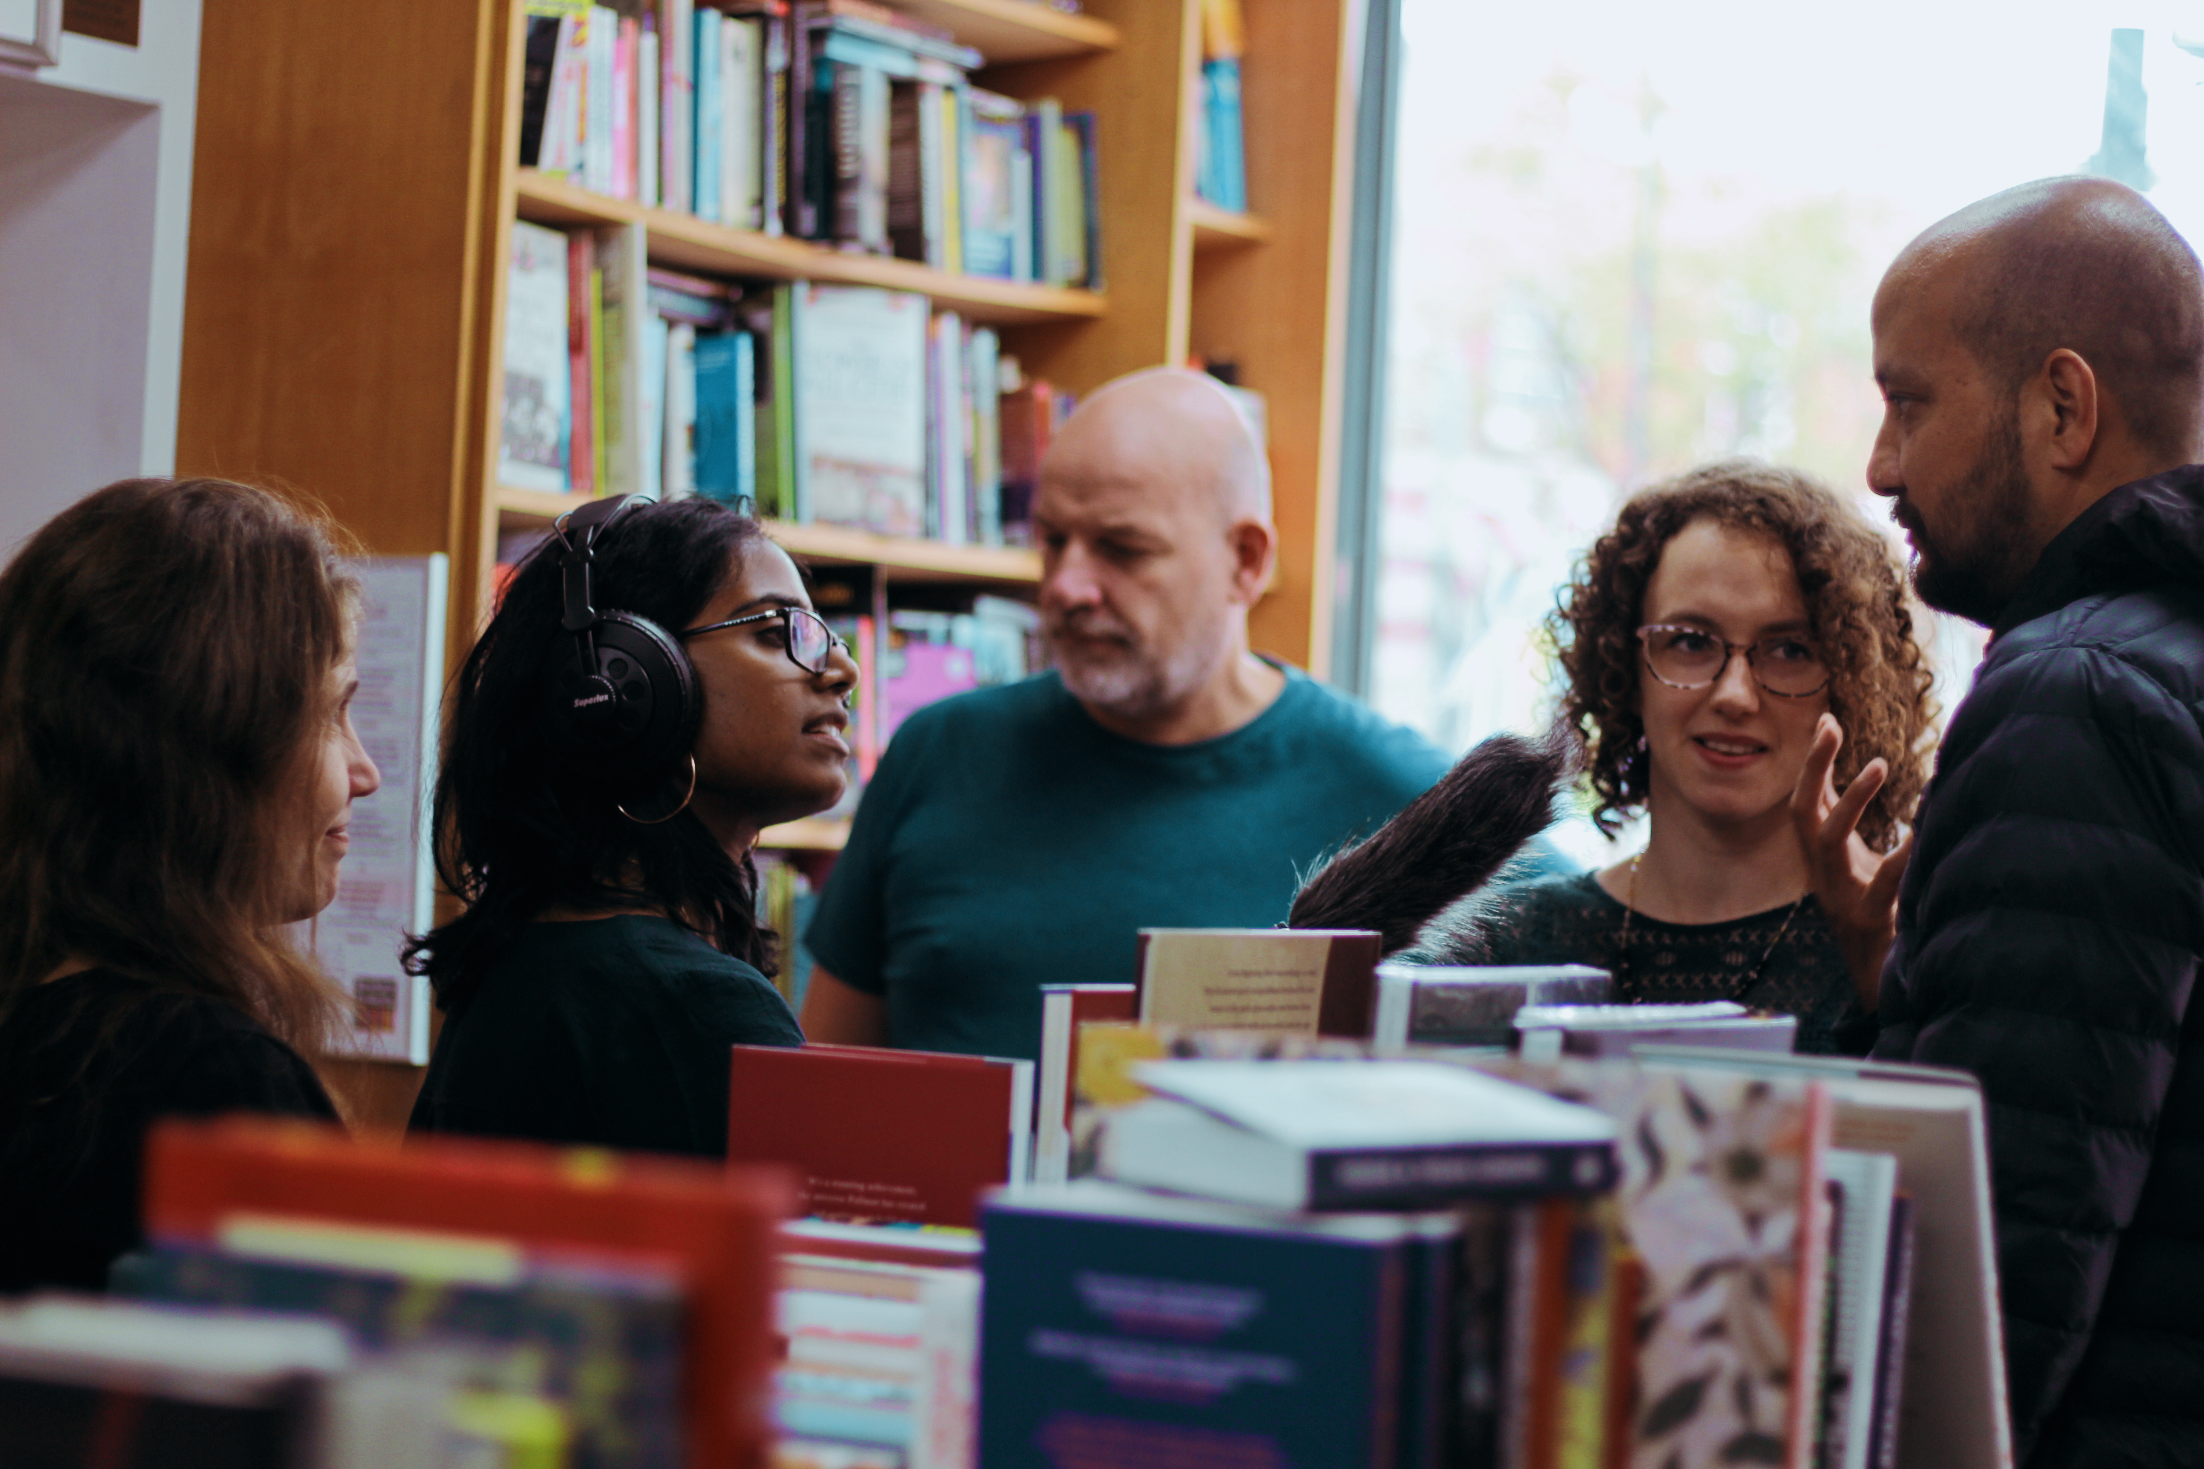
How do we know all this?
Interviews!
We learned about all of this by using interviews.
Rosa and Tania (on the left) had the fascinating job of meeting all of these people, and talking to them.
Being an interviewer is about asking good questions and listening carefully.

Slide 9
Now it is your turn...
We found out all of this information through interviewing local people.
We are all part of our local reading and writing community too.
Interview your partner, listen and write down their responses too.

Slide 10
Q1. What do you
like to read?

Slide 11
Q2. How do you feel when you are reading?

Slide 12
Q3. Tell me about your favourite writers

Slide 13
Q4. What do you like
to write about?

Slide 14
Q5. If you had to
choose, what local
place or person would you write about?

Slide 15
Next watch a video with John Newman, thanking everybody for taking the time to learn about Newham Bookshop, and about all the amazing readers and writers in our local community.
Some are children like you, and some are
one hundred years old, like Ada Varley.
You belong here, this is all for you.

