Slide 1
Being a writer in Newham
Resources made by Otherwise Education for On the Record.
Portait photographs by Fatimah Zahmoul. Film by Patrice Etienne.

Slide 2
Why do people write?
This is a simple question that can generate many answers.
Can you think of ten different reasons why somebody may choose to write?

Slide 3
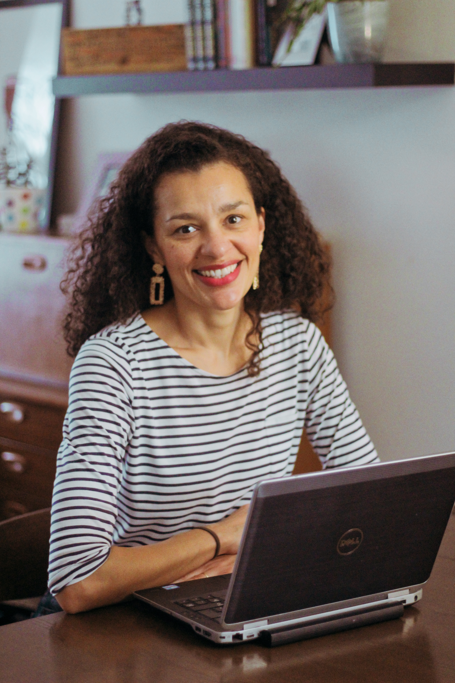
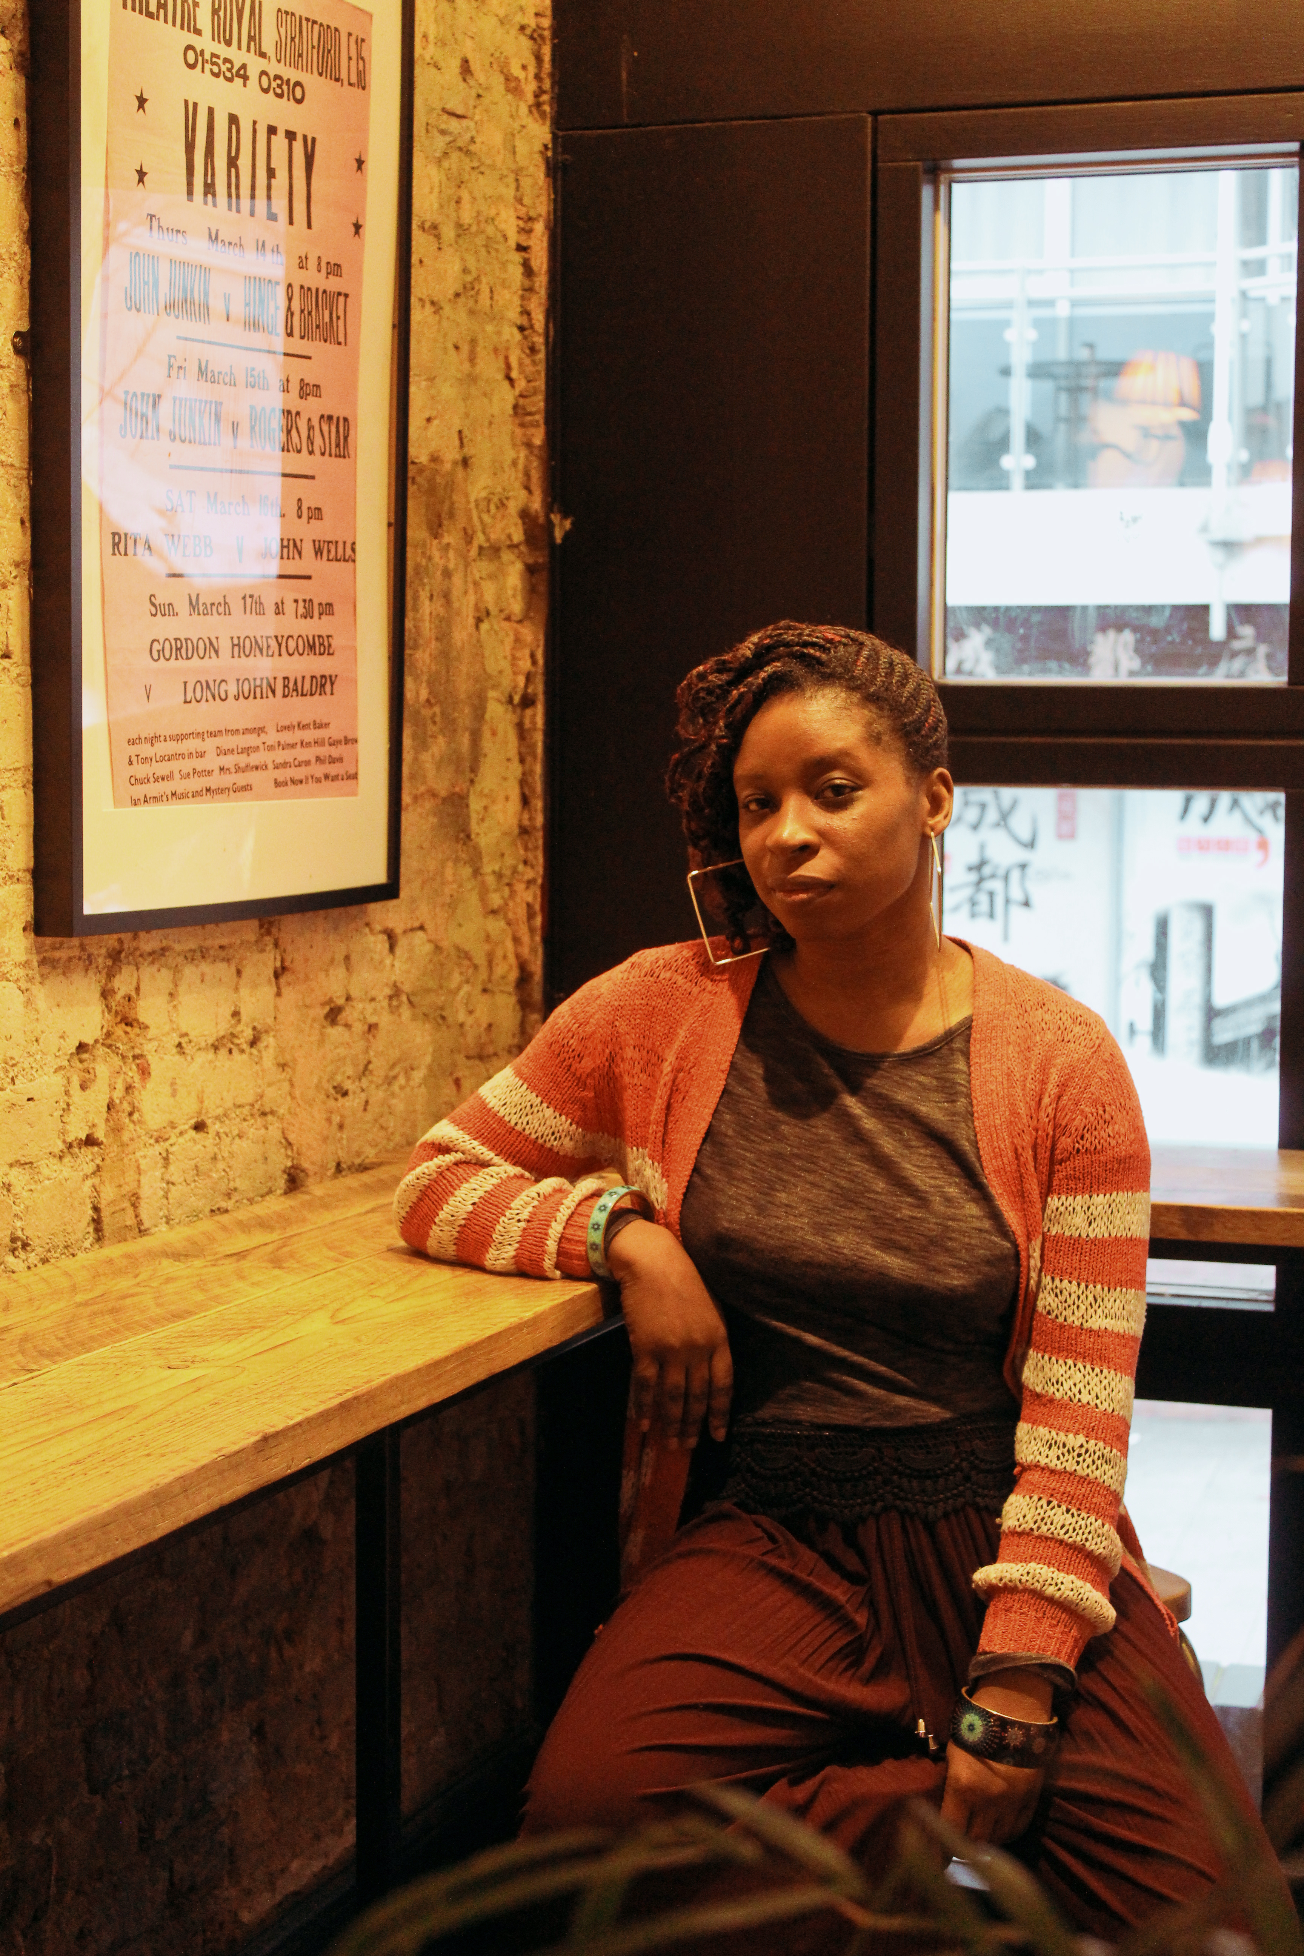
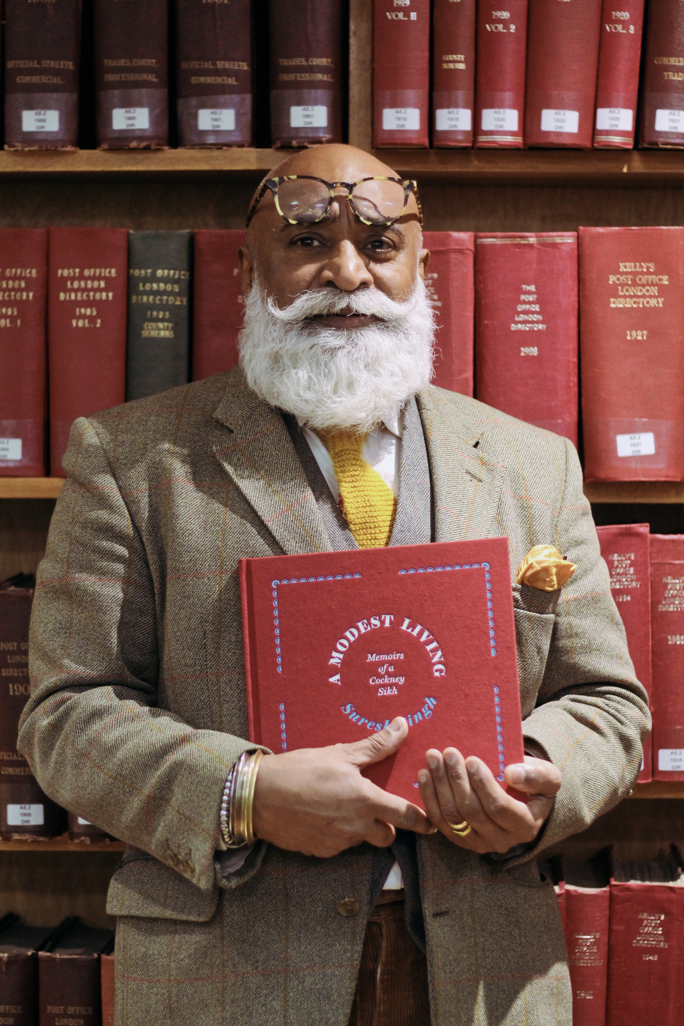
Photos of Newham writers
LUAN GOLDIE
VASEEM KHAN
IRENSOSEN OKOJIE
SURESH SINGH

Slide 4
Newham is a writing community. You can contribute towards it.

Slide 5
What will we do today?
Today we will be experimenting with some creative writing, and the one main rule is this:
our stories will be set somewhere in Newham.
You already have a head full of stories, and many experiences you can use as fuel for your writing. Think about the people you know, and the places you know here.
You will be given tips and advice from some Newham writers...

Slide 6
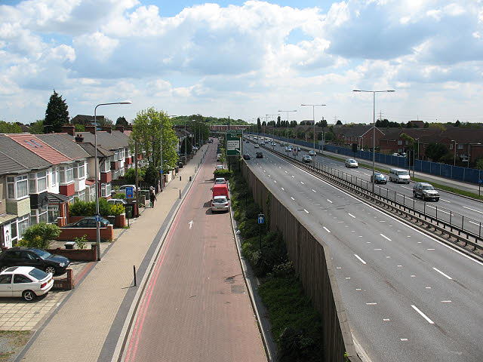
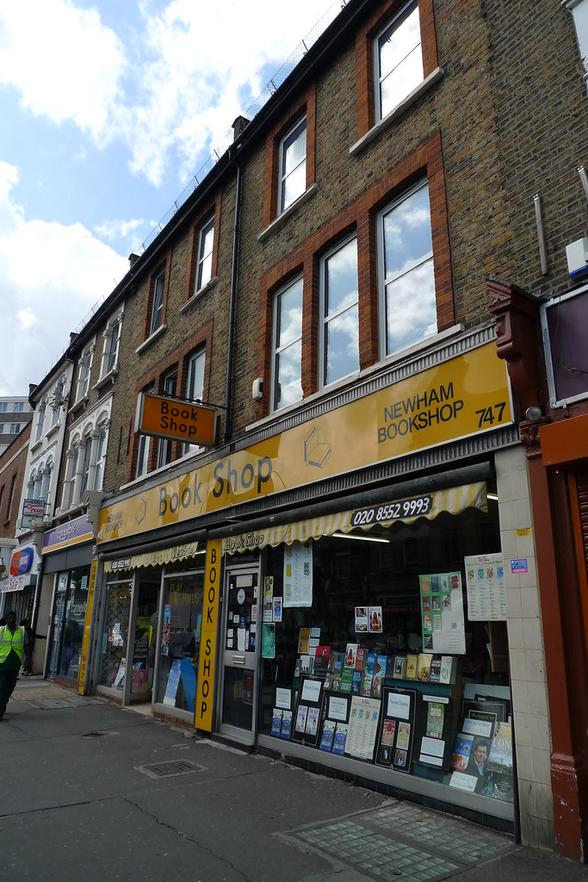
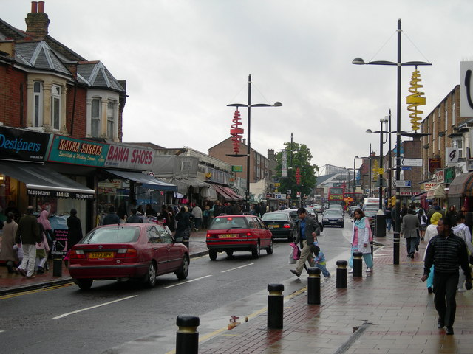

Slide 7
Tip 1 Be inspired by your local area
“A plot is like a bus route. You need to know where you are going before you start. In a space like London, you find these overgrown cracks, concrete places, and you think ‘somebody should have built something there’, but they didn’t.
I became obsessed with these spaces that nobody knows really what they are. There’s something almost fantastical about the spaces between the spaces where we live.”
ANDREW LANE

Slide 8
Tip 1 Be inspired by your local area
“I’m about 14,000 words into writing my third book, set in Stratford. I could see the house and I could see the characters walking around Stratford because… because I spend a lot of time in Stratford.
I think it’s an interesting area, what it’s going through and how it’s changed. And the good changes. At the moment it is just overwhelmingly bad change - the amount of homeless people in Stratford at the moment. It’s going to be a big part of this next novel.”
LUAN GOLDIE

Slide 9
Action 1: Think of five really specific places you know well in Newham, and note them down. Maybe where your family shops. Maybe where your family live. Where do people go for fun? Which place excites you most? Which place scares you most?

Slide 10
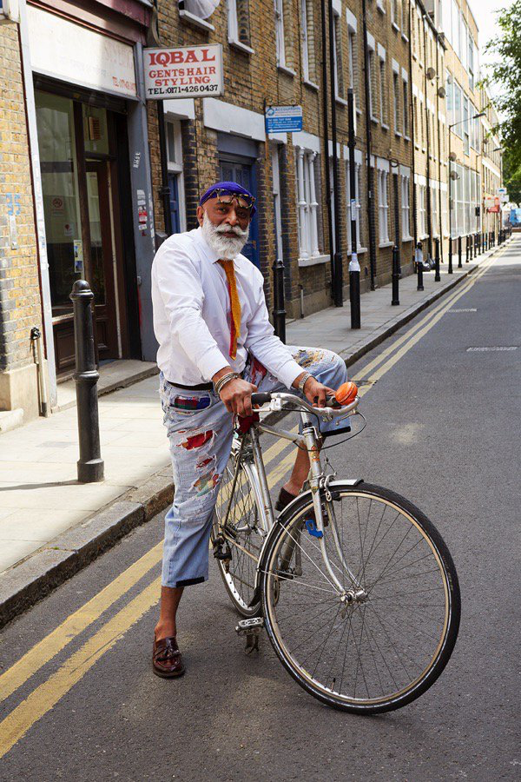
Tip 2 Be inspired by local people we know
“My book is sort of a love story to my father. And …. my father had lots of pictures, and there was a lot of pictures in his house. And I just thought that my dad had a story to tell, and because he is no longer here, I had to tell it.
A lot of these stories stay in people’s houses and indoors. I wanted to make it public and sort of shout it from the rooftops.”
SURESH SINGH

Slide 11
Tip 2 Be inspired by local people we know
“First I wanted to write something that was completely different from the environment I was in and that I knew. Later I tried to write some more contemporary stuff which was focused on growing up in an immigrant family in a place like Newham. And then I went back to the series that I currently write, the Baby Ganesh series, which is about India because I spent ten years living in India.”
VASEEM KHAN

Slide 12
Who could you include in your story? It might not mean that these people are ‘characters’ but you can write ‘parts’ of their personalities into your characters. LIST 5 PEOPLE YOU COULD INCLUDE

Slide 13
Tip 3 Bring your own cultures and experiences to the page
“Manor Park Library was quite a popular library for me at one stage. Forest Gate Library as well, I would often go there. And some of the salons as well… Because I would often take my younger brother to the salon, there was a barber’s within the salon. Black barber shops are absolutely amazing, and fascinating, and the conversations that happen there are hilarious, and all sorts of debates go on for hours. And so depicting some of that within the stories has been fun as well.”
IRENOSEN OKOJIE

Slide 14
Tip 3 Bring your own cultures and experiences to the page
“So, actually, when I trace it right back, it’s not a surprise that I write the way I write, because it’s in my literary DNA so to speak, going right the way back to oral storytelling in Nigeria with my grandmother and cousins. That was really lovely. And we would eat, and share…”
IRENOSEN OKOJIE

Slide 15
ARE THERE STORIES THAT HAVE BEEN SHARED WITH YOU IN YOUR FAMILY? Sometimes, we can inherit stories from family and friends, often linked to our culture, language and religion. By retelling and reimagining and sharing these stories, we keep them alive. SHARE SOME IDEAS BASED ON STORIES YOU HAVE HEARD.

Slide 16
Tip 4 Own your space as a writer
“And I think there is something that books can do, books have that power, you know. Which is why diverse stories are really important for, all sorts of audiences to have access to. Because I think through reading we create empathy, we see the commonalities, and all of that is really, really powerful. So I think that’s what want my readers to take away from my stories. It’s humanising characters on the fringes, showing them in a way that, they may not have seen them before.”
IRENOSEN OKOJIE

Slide 17
Tip 4 Own your space as a writer
“So, yeah, I’d say, just have a bit of determination really, and write about what you know and what you love as well. Because, you know, I never thought I’d be able to make a living writing about West Ham, but, I actually have done in the end.”
PETE MAY

Slide 18
Let’s write. Use your locations, people and stories from your notes. What event could launch your short story? Describe the location in detail, so the readers can really imagine themselves there. Think about what makes your people unique, and share this.

Slide 19
Watch the video.

