Slide 1
When is a bookshop more than just a bookshop?
Resources made by Otherwise Education for On the Record.
Portait photographs by Fatimah Zahmoul. Film by Patrice Etienne.

Slide 2
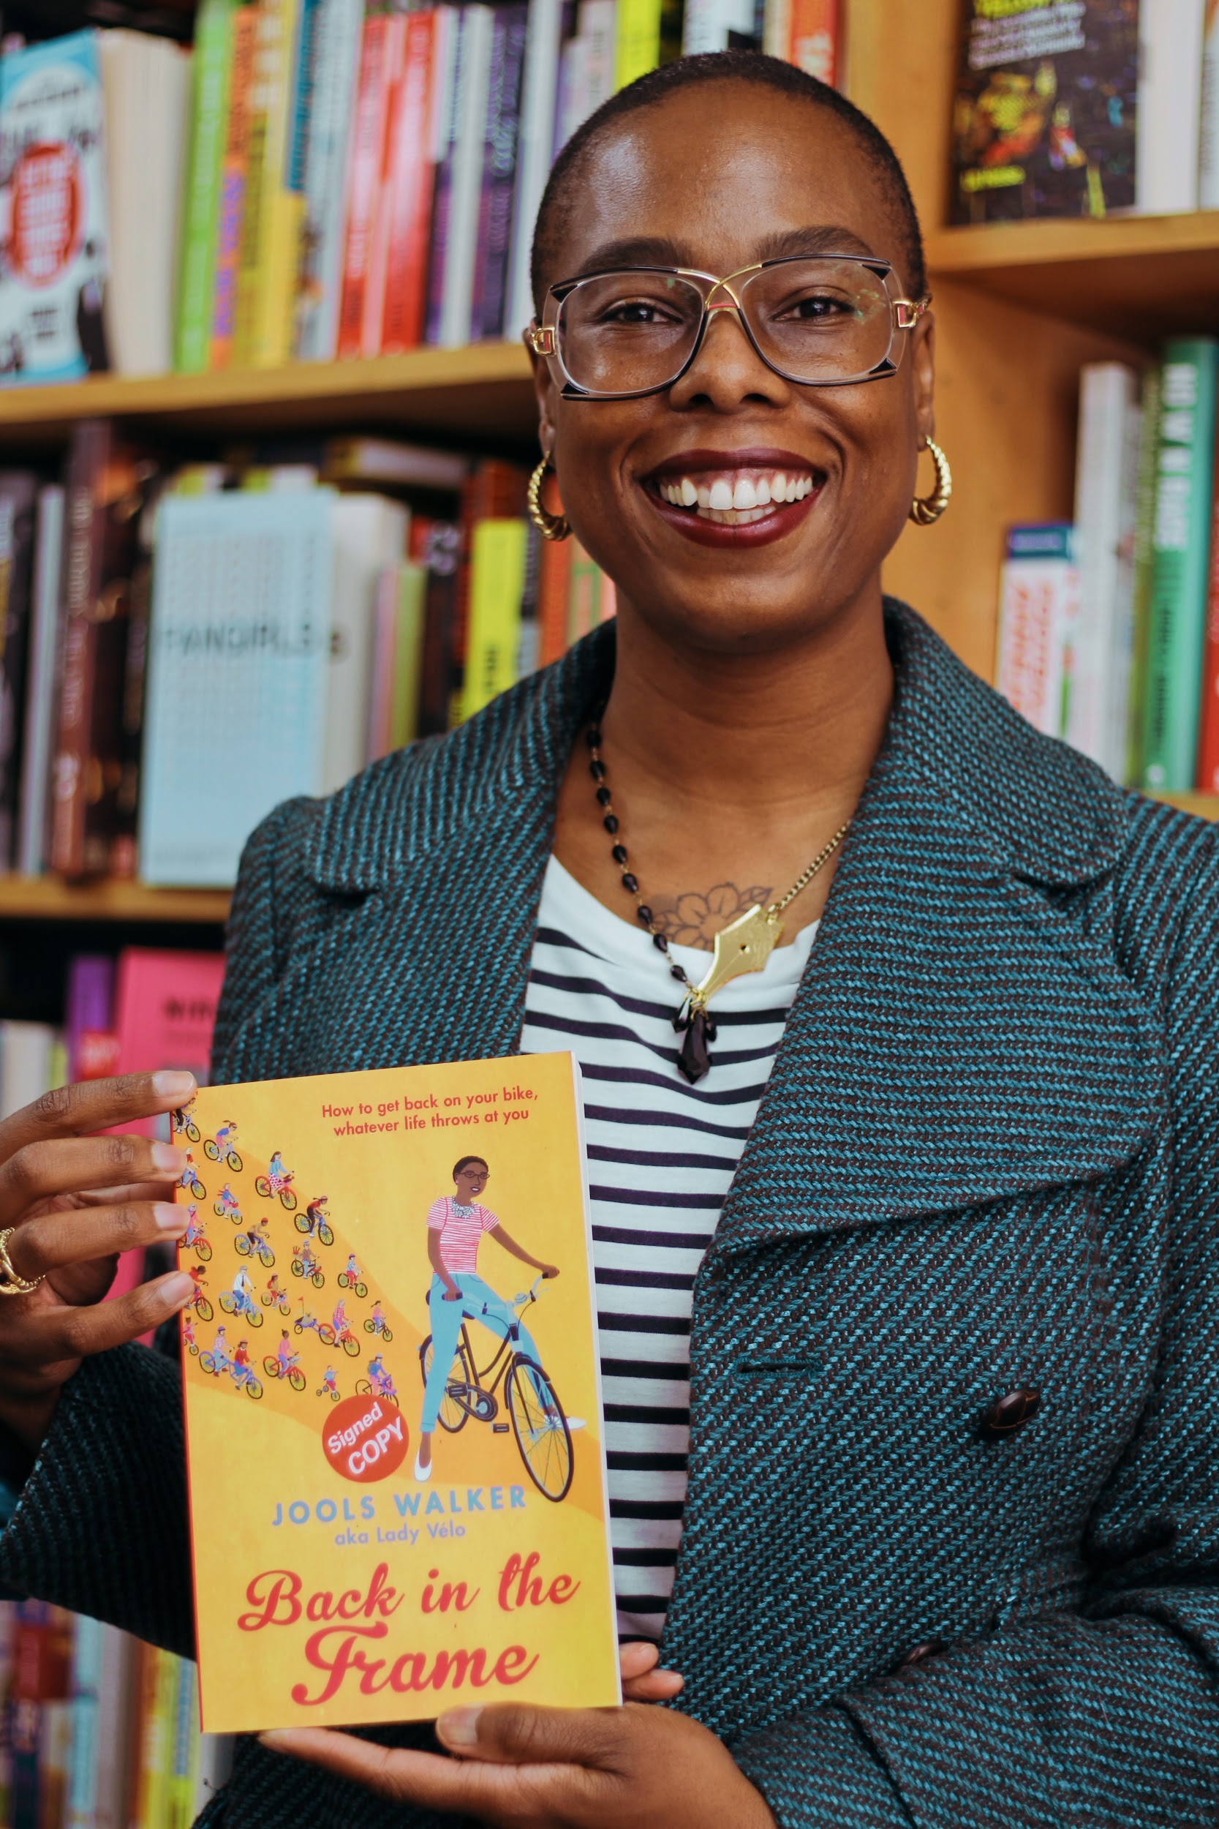
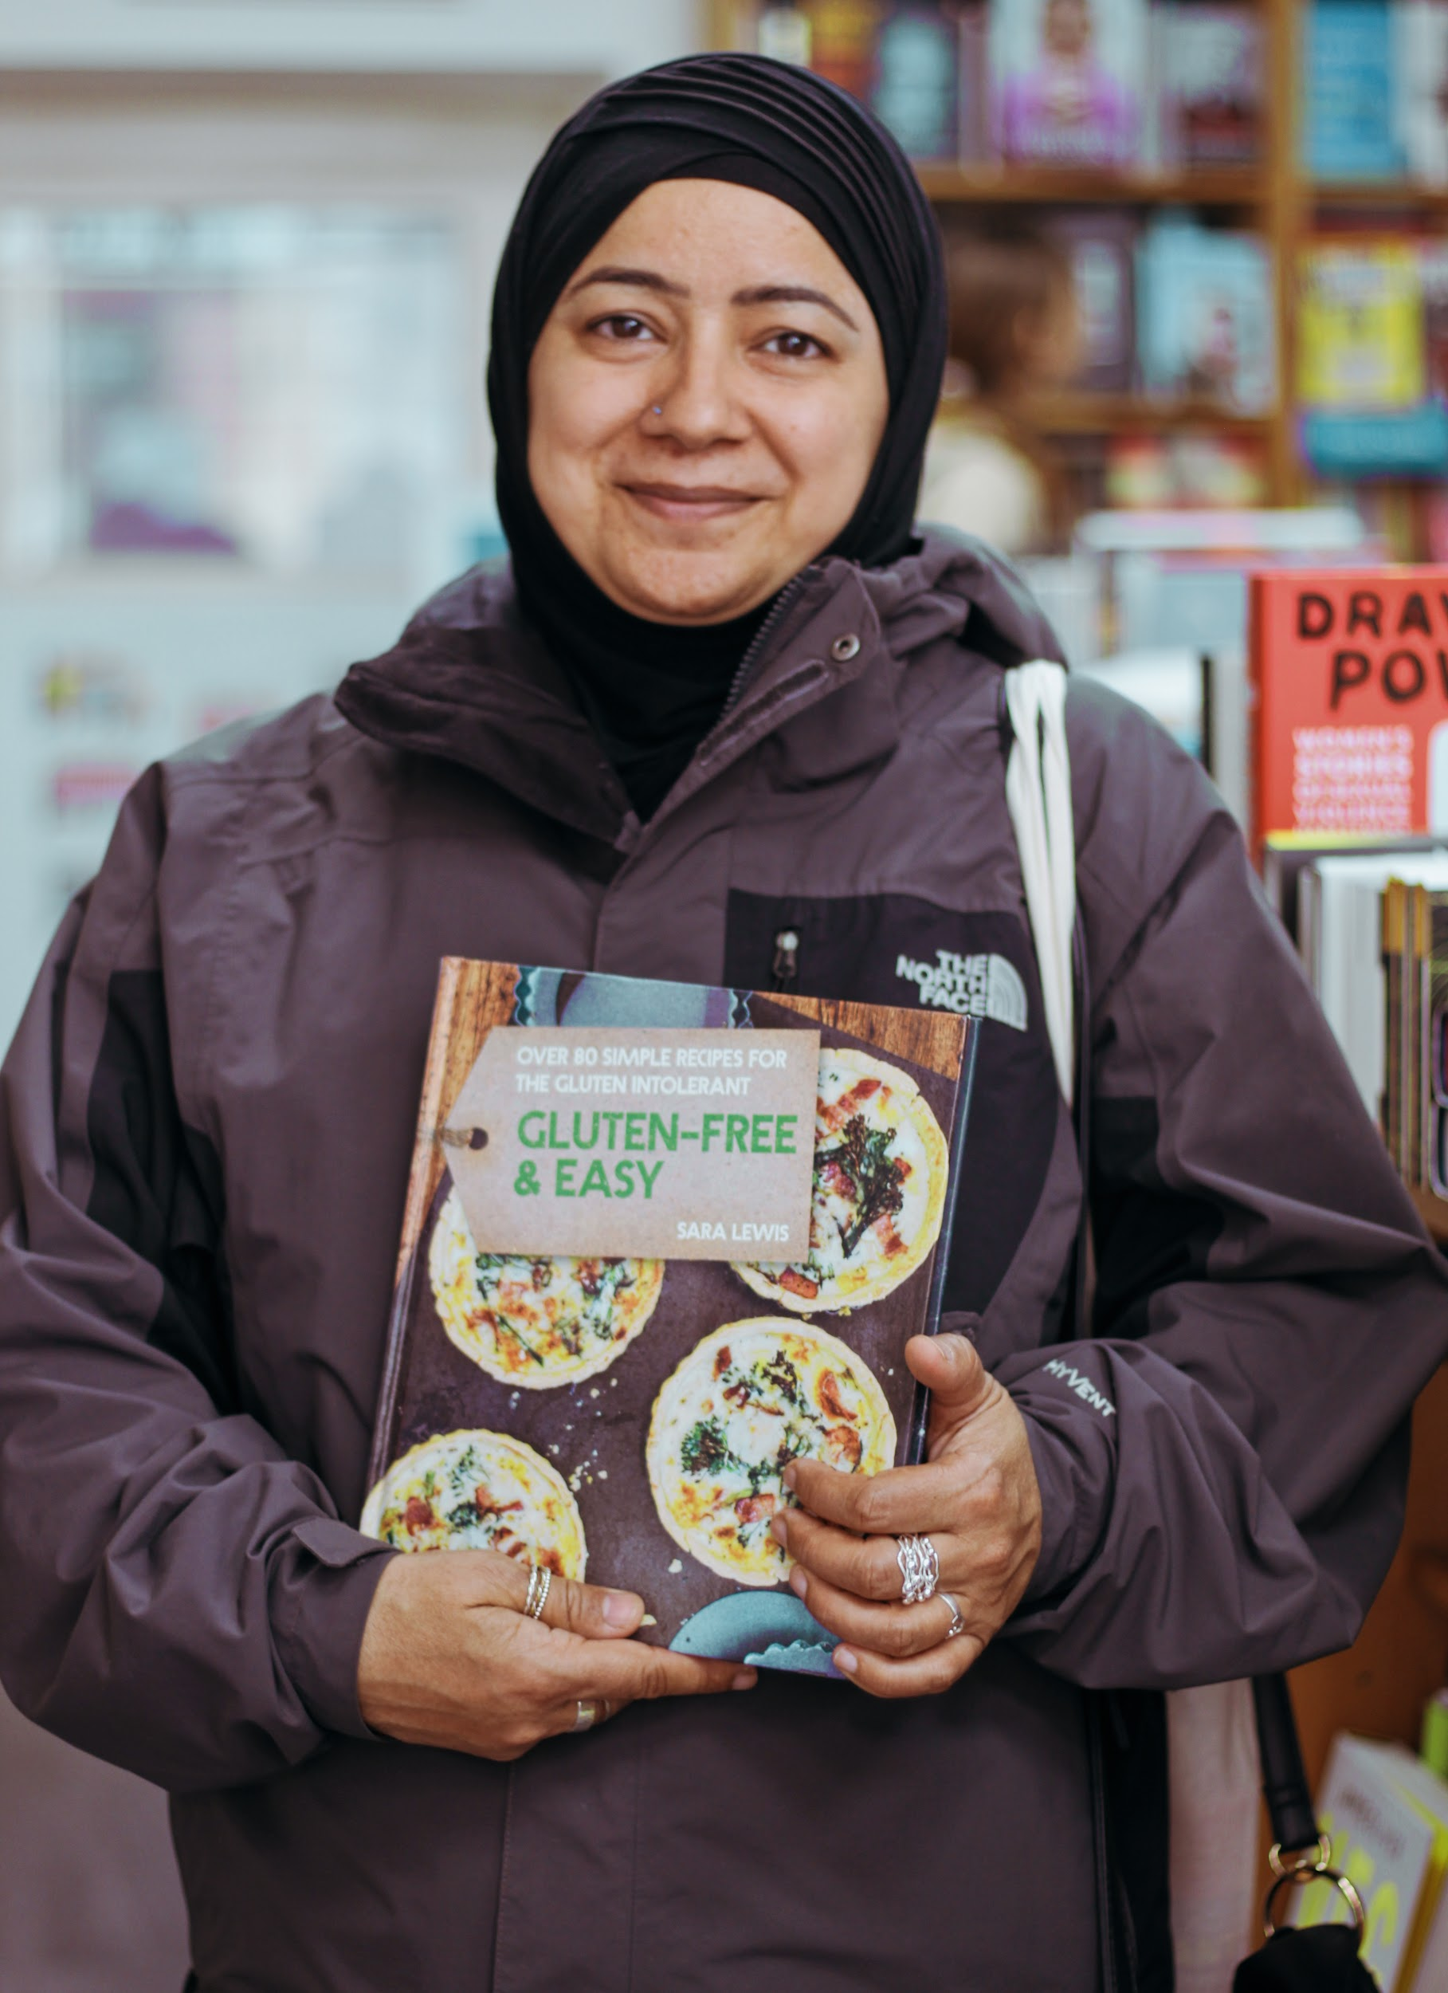
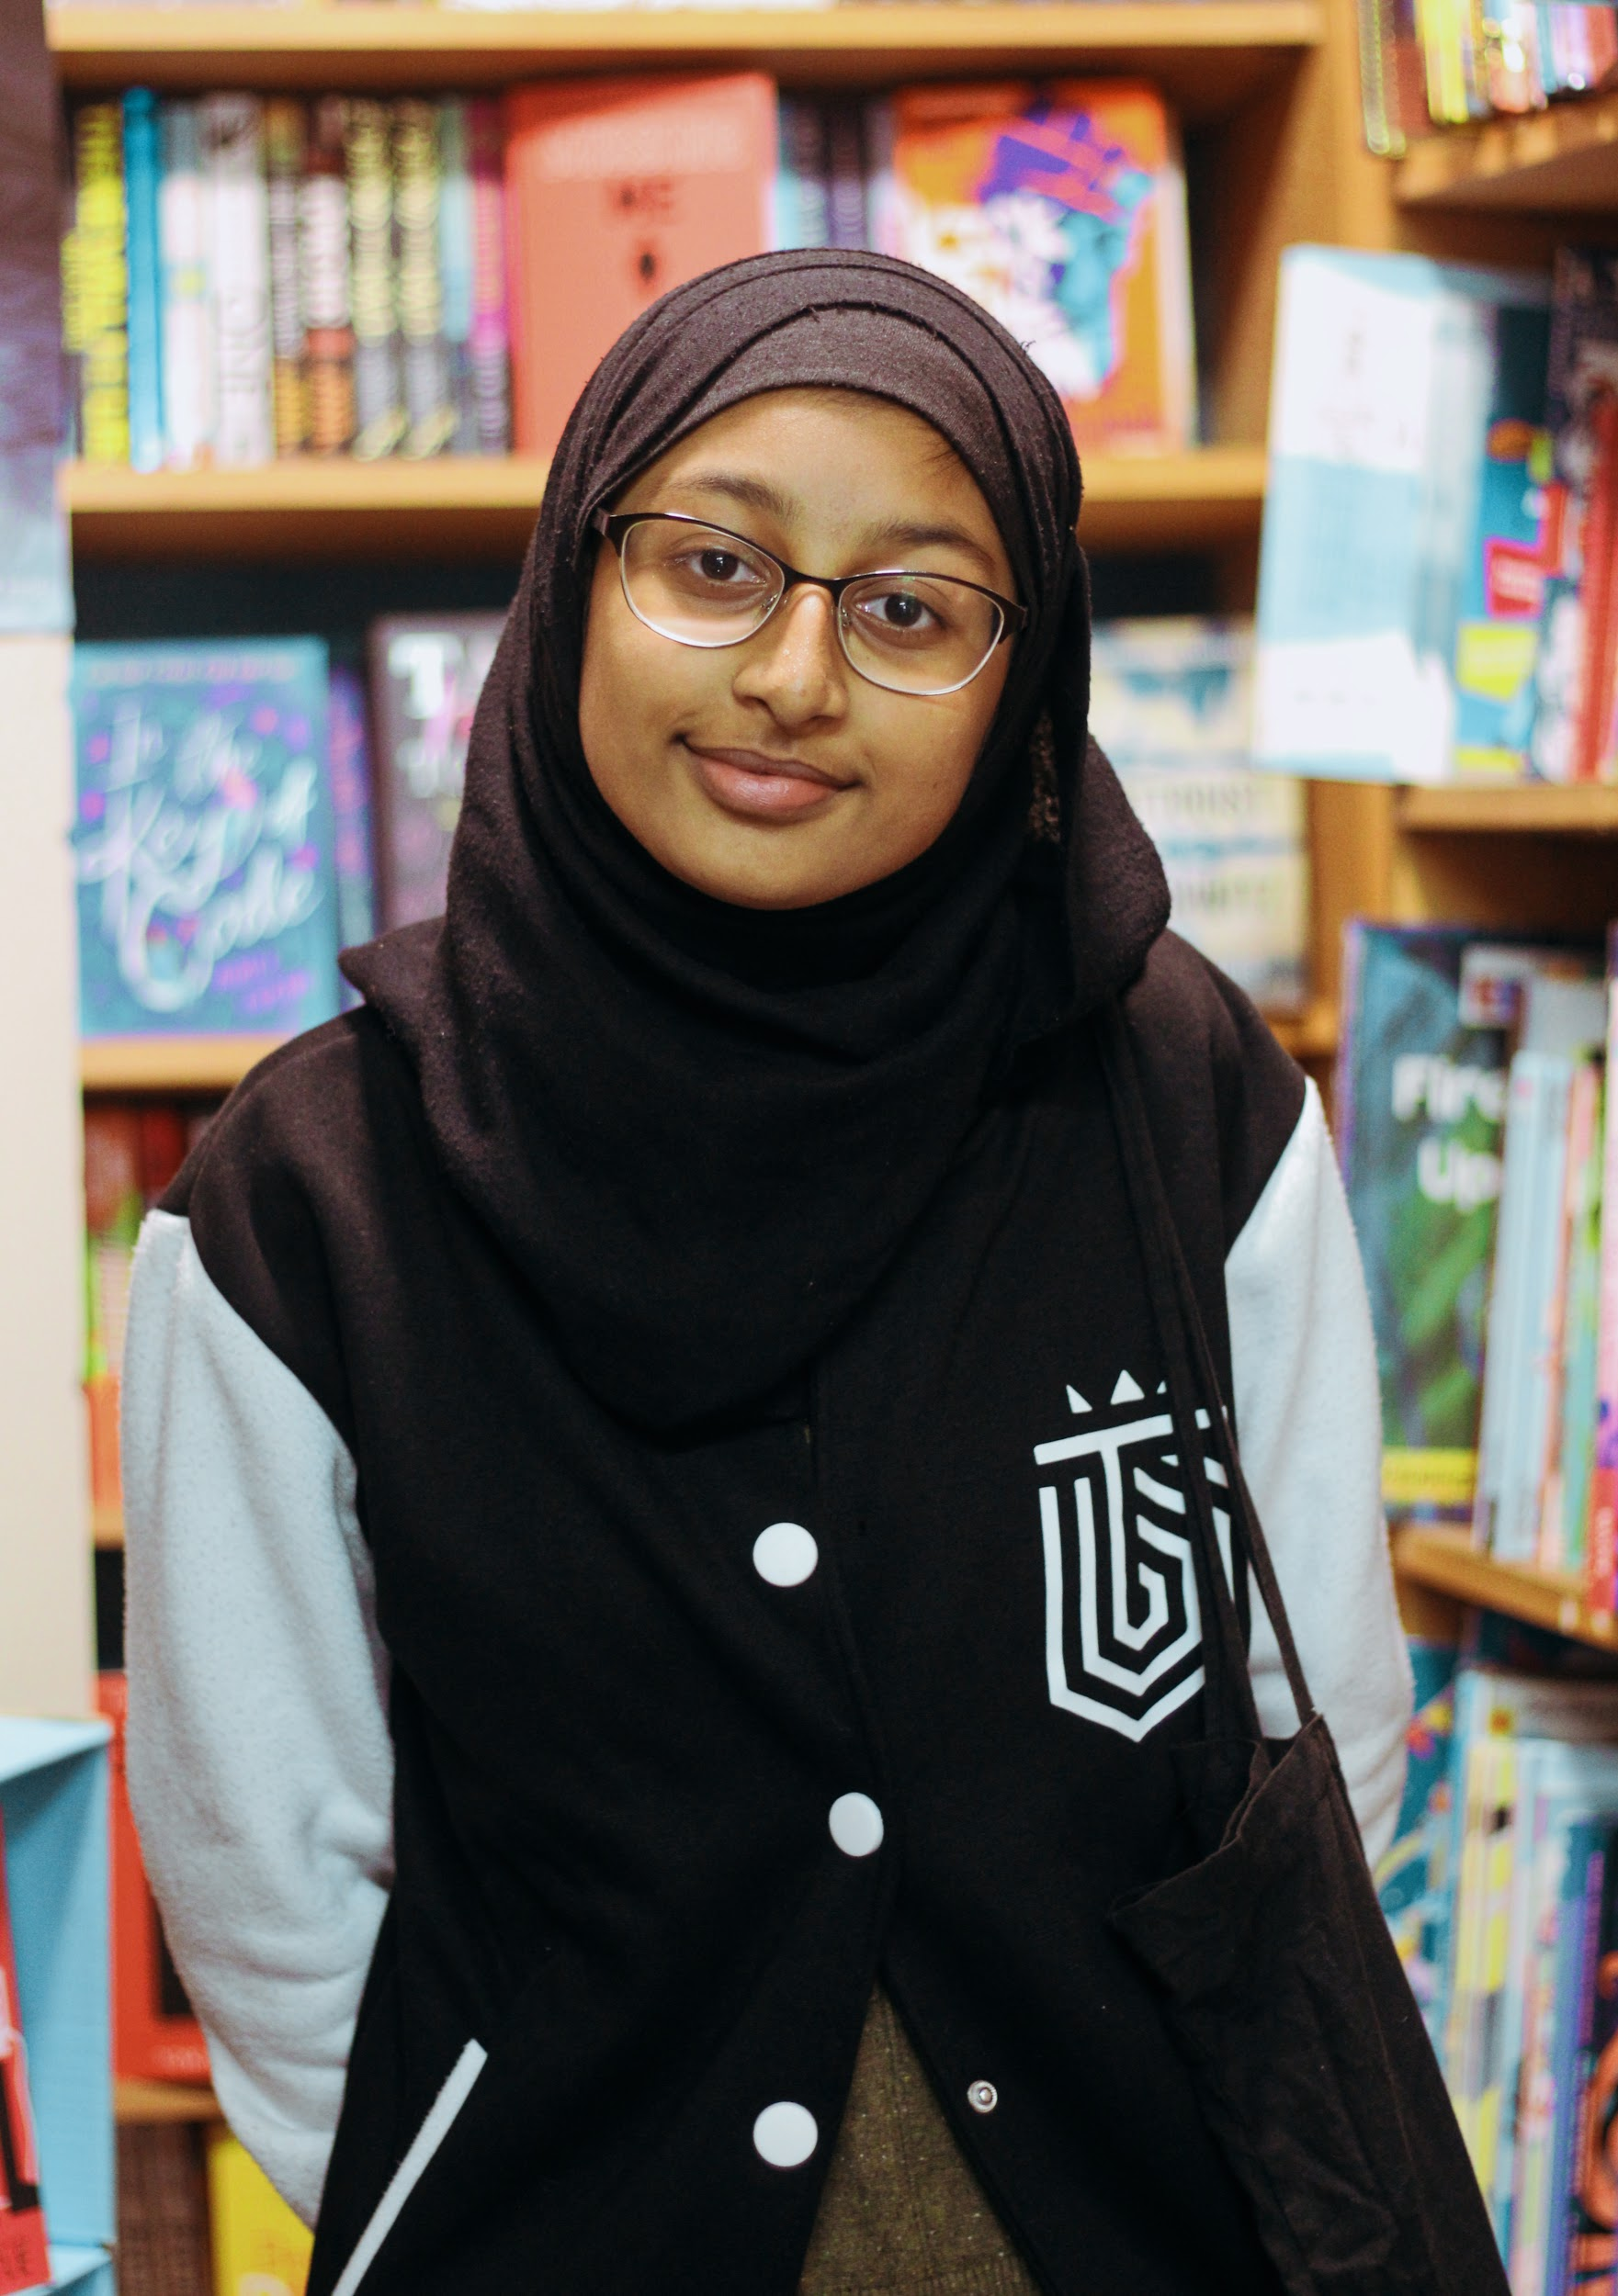
WHAT MIGHT LINK ALL OF THESE PEOPLE?
WHAT ARE THEIR SIMILARITIES AND DIFFERENCES?

Slide 3
NEWHAM BOOKSHOP
How could so many different people be linked to a bookshop?

Slide 4
What is a bookshop?

Slide 5
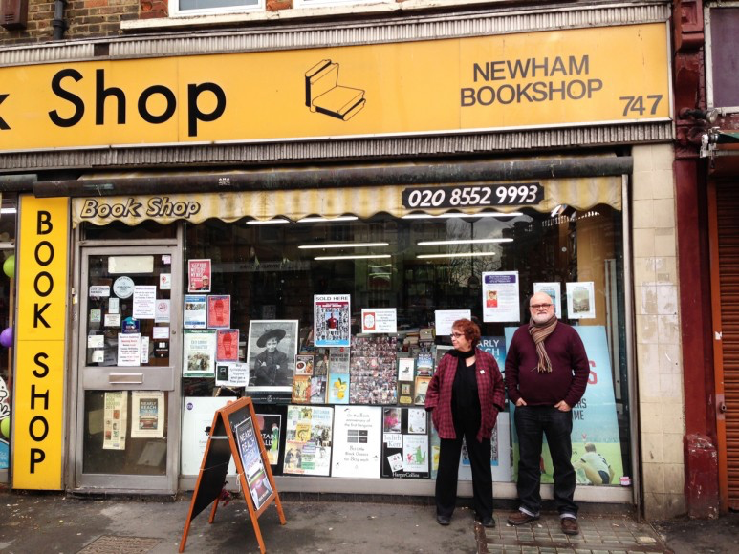
John Newman
Vivian Archer
Let’s Learn
Some people from our photographs have things to say about Newham Bookshop.
How can a bookshop be more than just a shop for books?
Notes:
Whilst this slide is showing, children explore the quotations in groups. These could be cut out, if not printed double sided.
They can match them to the photocards.

Slide 6
a place to inspire children to read and write
a community-minded place to make friends
a defender of the right for all people to be educated
a proud guardian of our local history
a place to celebrate publishing your first book

Slide 7
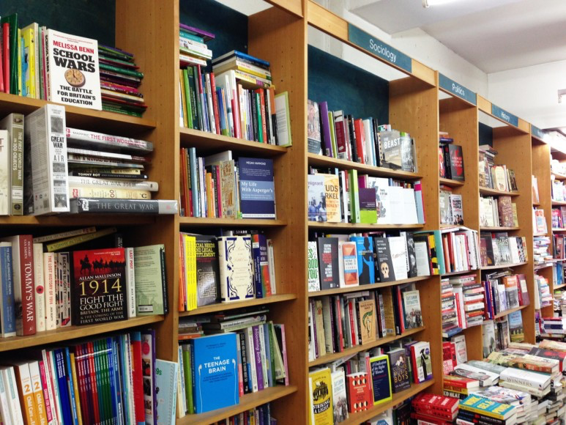
Newham Bookshop
is all of these things and more.

Slide 8
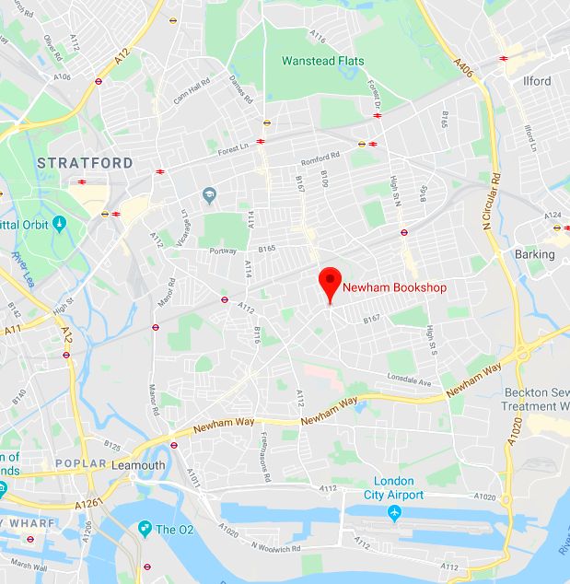
Newham Bookshop is on Barking Road, in the heart of Newham.
It is a proud part of our local history.
It belongs to you.

Slide 9
Let’s go there... watch the video.

Slide 10
Reading for Pleasure Writing for Pleasure The Literacy Life of Newham
Ready for our next lesson, start thinking about which books help tell the story of who you are.
What are your favourite books?
What do your family members read?
Where do you get your books?
How does reading help you?

